Slide 1
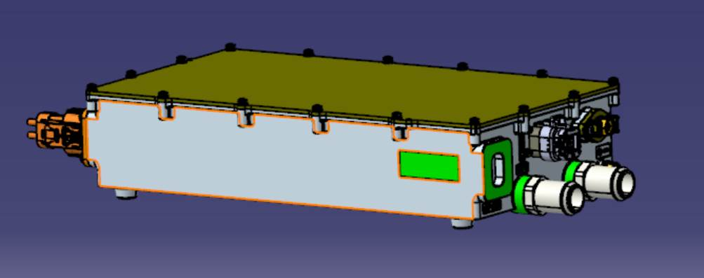

6.0kW DC-DC Converter
Proven in Thousands of Commercial EVs & HEVs
6.0 kW Output
24V Output Voltage
Light Weight, Compact Design
Wide Range DC Input
CAN Controlled
Liquid Cooled
Meets Conventional Truck & Bus Requirements
GENERAL SPECIFICATIONS
Model #: | eDCDC6.0HV-24V
Rated Output Power: | 6.0 kW Continuous
Input Voltage Range: | 180-750 V_{DC}
Communication: | CAN 2B
Output Voltage Range: | 24-30 V_{DC}
Output Current: | 220 A Continuous
Cooling: | Liquid Cooled Water Glycol
Coolant Temperature: | -30 ℃ to +65 ℃
Operating Temperature: | -40 ℃ to +85 ℃
Environmental Protection: | IP67
Weight: | 16.3 lbs (7.4 kg)
Dimensions: | 17.5"L × 8.3"W × 3.3"H (443.9 mm × 210.6 mm × 85mm)
Coulomb Solutions Inc.
6013 Las Positas Road, Livermore, CA 94551 www.coulombsolutions.com

