Slide 1
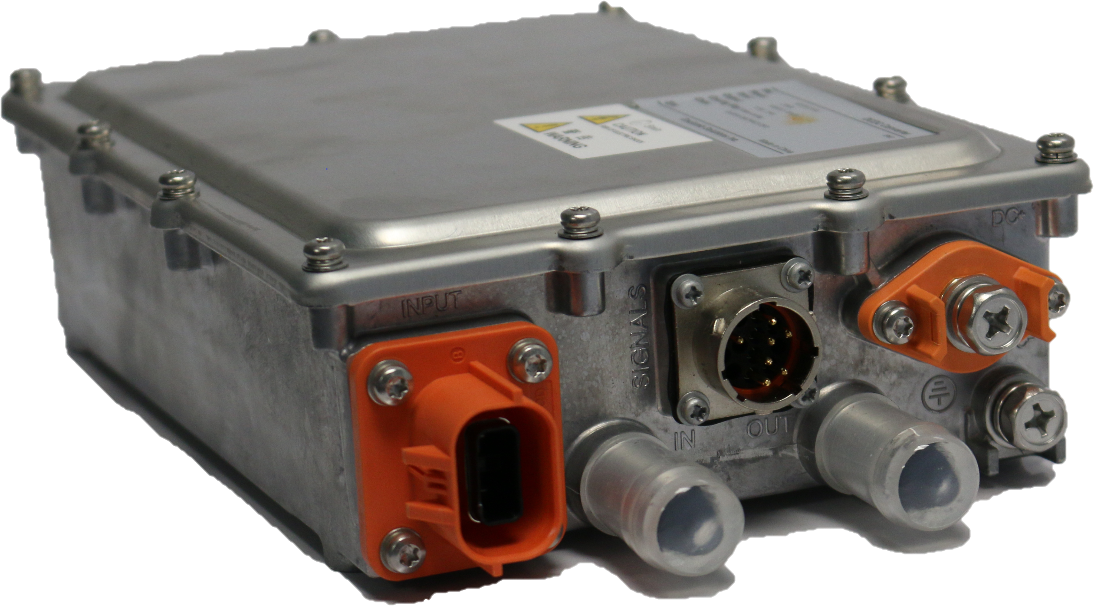

2.5kW DC-DC Converter
Proven in Thousands of Commercial EVs & HEVs
2.5 kW Output
12V output voltage
Light Weight, Compact Design
Wide Range DC Input
CAN Controlled
Liquid Cooled
Meets Conventional Truck & Bus Requirements
GENERAL SPECIFICATIONS
Model #: | eDCDC2.5HV
Rated Output Power: | 2.5 kW Continuous, 2.8 KW Peak Output
Input Voltage Range: | 400-750 V_{DC}
Communication: | CAN 2B
Output Voltage Range: | 12-14 V_{DC}
Output Current: | 180 A Continuous, 214 A Peak (6 mins)
Cooling: | Liquid Cooled Water Glycol
Coolant Temperature: | -30 ℃ to +65 ℃
Operating Temperature: | -40 ℃ to +85 ℃
Environmental Protection: | IP67
Weight: | 7.5 lbs (3.4 kg)
Dimensions: | 10.7"L × 7.0"W × 2.7"H (273 mm × 177 mm × 68 mm)
Coulomb Solutions Inc.
6013 Las Positas Road, Livermore, CA 94551
www.coulombsolutions.com

